Slide 1
CODES-Tracer tutorial
erhtjhtyhy
Enabling hpc design space exploration via discrete-event simulation
Nikhil jain
Neil McGlohon
Compute Architect
NVIDIA
PhD Student Researcher
Department of Computer Science
Rensselaer Polytechnic Institute
Adapted from N. Jain and M. Mubarak’s slides for HOTI2017

Slide 2
slides
Available for download at:
http://nikhil-jain.github.io/codes-hoti.pptx
https://github.com/codes-org/codes
https://github.com/ROSS-org/ROSS
https://github.com/LLNL/TraceR

Slide 3
Tutorial outline
Session I: Introduction to CODES and TraceR, and their use for simulations
Session II: Replaying HPC workloads, simulating MPI operations and collectives
Session III: Storage simulations, Misc

Slide 4
PROJECT contributors
Argonne National Laboratory, Mathematics and Computer Science
Lawrence Livermore National Laboratory, Center for Applied Scientific Computing
Nvidia, Compute Arch
Rensselaer Polytechnic Institute, Computer Science
University of Arizona, Computer Science
UC Davis, Computer Science
University of Maryland, Computer Science

Slide 5
Session I: introduction, case STUDY, and interconnect models

Slide 6
Goals of session I
Introduction
Case study
Features
HPC Interconnect models
Configuring interconnect simulations
Interpreting simulation output

Slide 7
Introduction & background

Slide 8
Building blocks of hpc interconnects
HPC performance is sensitive to the interconnect latency
Interconnects are custom built to achieve maximum throughput
Basic Components:
Network topology: Arrangement of network nodes and links to maximize performance.
Routing: The protocol using which a packet selects its next destination. Depends on the underlying network topology.
Flow control: Allocating network links and buffers to packets as they traverse through the network. Usually independent of the underlying topology and routing protocols.

Slide 9
Why HPC Interconnect simulation?
HPC interconnects are complex!
Need to look at several factors that influence network performance:
Interconnect Topology
Routing
Quality of Service
Job placement policies
Inter-job and intra-job interference
Storage placement on network
Improved performance is contingent on an optimal combination of the above factors

Slide 10
Ross: parallel discrete-event simulator
Discrete event simulation (DES): a computer model for a system where changes in the state of the system occur at discrete points in simulation time
Parallel DES allows execution of simulation on a parallel platform
Rensselaer Optimistic Simulator System (ROSS) provides PDES capability for CODES
Optimistically schedules events. Rollback realized via reverse computation
Logical processes (LPs) model state of the system
Notes:
ROSS has Logical processes or LPs that model the state of a system for example an LP can be a server in a queueing network.
Events are issued by these LPs (Logical Processes) and each event computation can modify LP’s state variables and schedule new events in turn. For example, denoting the arrival of a new job at the server.
ROSS uses time warp synchronization protocol to process events. If the synchronization protocol detects an out of order event, the events are rolled-back and re-executed in the correct order. This enables much richer simulations (e.g., more events) than otherwise possible

Slide 11
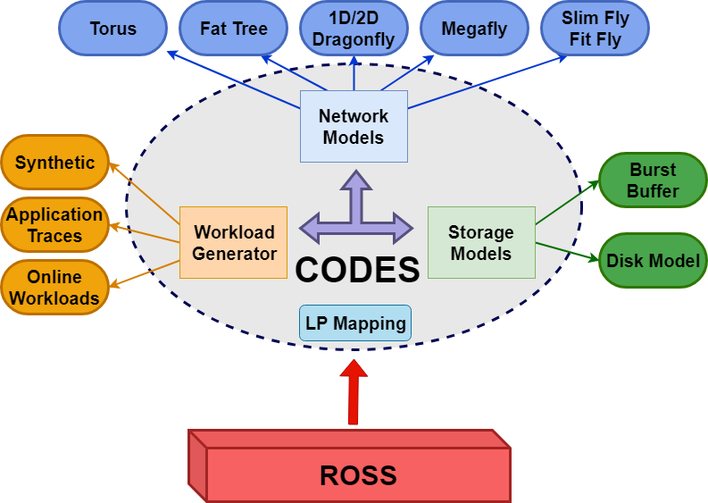
CODES: modeling & Simulation framework
Accelerate HPC system co-design by providing a detailed simulation of HPC interconnects, storage, workloads and surrounding environment
Couple best-of-breed parallel discrete event simulation with experts in interconnects and storage architecture design
Incrementally develop HPC simulation capability, validating approach and components along the way
Complement experimentation on real systems
Figure: CODES Architecture Diagram
Notes:
Vision
Develop an infrastructure that accurately reflects relevant system properties
Leverage this infrastructure as a tool for investigating HPC architecture design
Eventually, provide a simulation toolkit to the community to enable broader investigation of the design space

Slide 12
Tracer: replaying mpi traces
OTF2 traces for MPI
BigSim traces for Charm++, AMPI
Default and user-defined job placement and task mapping
MPI point-to-point semantics and protocols
Inbuilt collectives: tree based bcast, reduce, allreduce, and barrier; message size based algorithms for alltoall and allgather
Simulation time scaling

Slide 13
Features: HPC Simulations
Packet-level simulations of HPC interconnect topologies
Trace-driven analysis (DUMPI+OTF2), synthetic workloads
Multiple jobs can be replayed on the network
Different job placement schemes can be used
Multiple ranks mapped to network nodes can be used
Detailed statistics generation
MPI collective operations can be simulated
General purpose storage model that uses concurrent, pipelined RDMA read/write requests (simulating burst buffers/SSD)

Slide 14
simulation stack
Workloads: Session II
System Models in Session I & III
Notes:
Workloads
MPI simulation layer + synthetic workloads
MPI simulation layer replays MPI operations from the traces on the CODES HPC system simulations.

Slide 15
Hpc interconnect models

Slide 16
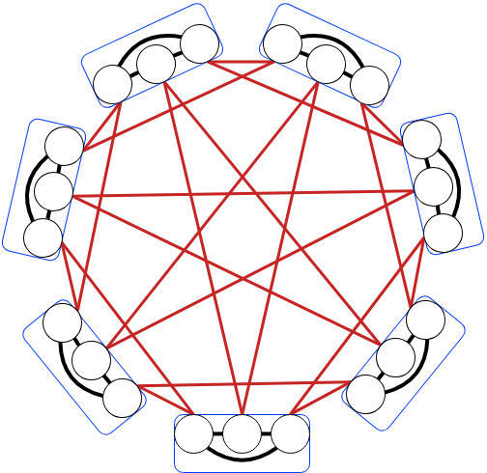
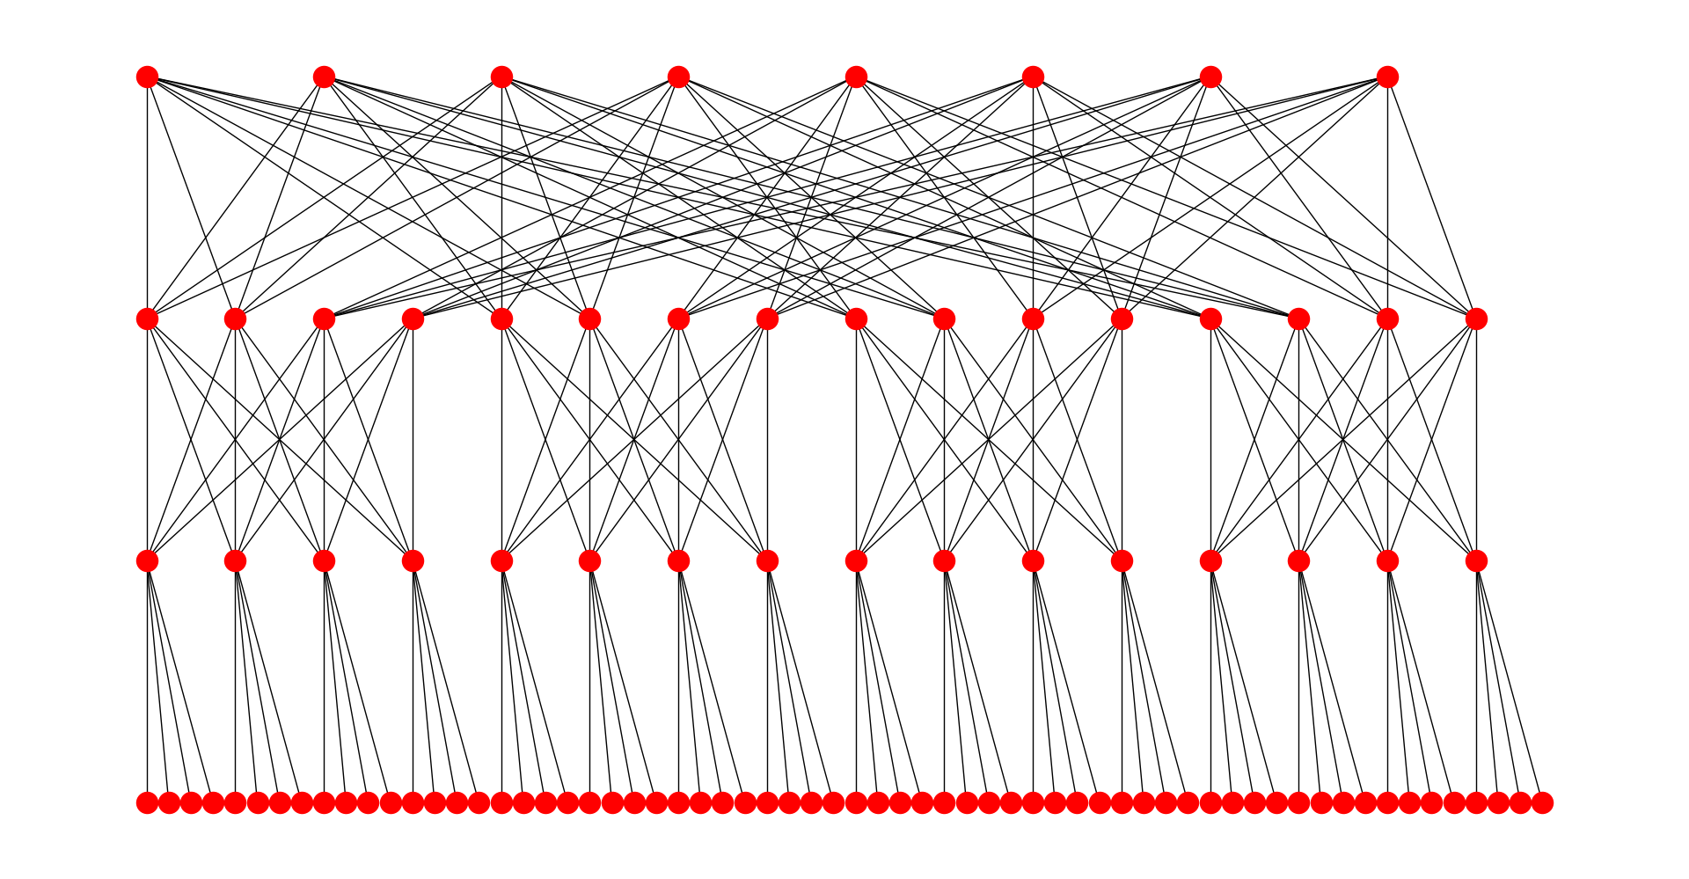
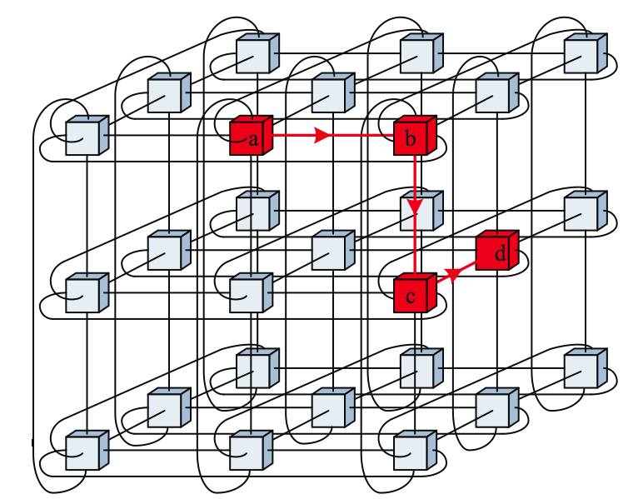
Structure of modern interconnect topologies
Slim Fly Network
Cost-Effective
Low-Diameter-High-Path-Diversity
Complex Global Link Structure
Dragonfly Class Networks
Groups with All-To-All Global Connections
Flexible Routing
Strong resilience to inter-job interference
An 8 Group Slim Fly
Torus Network
Homogeneous structure
Dedicated routers per compute node
A 7 Group Dragonfly
Fat tree Network
Static Routing
Job placement impacts inter-job interference
A 3-ary 3-d Torus network
A 3-level pruned Fat Tree with 64 compute nodes
Notes:
Torus had a homogenous n-dimensional structure with one router dedicated per compute node. Two nodes used to have a dedicated link between each other. Short electrical links were used.
With high-radix networks such as dragonfly, each router is shared by multiple compute nodes at the first level. The routers in a group are connected to each other in either an all to all structure or a matrix format. Groups are connected to each other via optical links. There is different link connectivity at each of these levels.
Structure of a Cray XC style dragonfly network. Routers within a group are arranged in a two dimensional matrix and there are different types of links at each level.
Routers arranged in a row are connected in an all to all fashion via green electrical links. Chassis.
Across the rows, routers in the same columns are connected to each other via 3 black links.
Across the groups, 12x or 24x optical cables are used. If this optical cable between two groups fails, then one has to reach the group via non-minimal path.
Fat tree networks are also based on high-radix switches. They use static routing though which involves routing tables that need to be rebuild once the network configuration is modified. Job placement is the key to reduce interference in fat tree networks. If the application spans one pod or less than one pod then the routing doesn’t go to top level switches.

Slide 17
Overview of network models
Multiple network models are supported – 1D/2D Dragonfly, Megafly, Slim Fly, Fat Tree, Express Mesh, Arbitrary graphs, Torus…
Abstraction layer ‘model-net’ sits on top of network models
Breaks messages into packets
Offers FIFO, round robin and priority queues
To try different networks, simply switch the network configuration files!
Storage models, MPI simulation and workload replay layers are independent of the underlying networks

Slide 18
Simple net network model
A latency/bandwidth model where message is directly sent from source to destination
Uses infinite size queuing
Easy setup– uses a startup delay and link bandwidth for configuration
Mostly for debugging/testing purposes-- Can be used as a starting point when replaying MPI traces
It can be used as a baseline network model with no contention and no routing

Slide 19
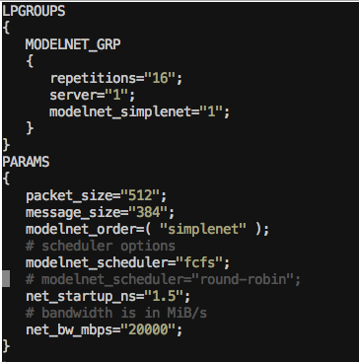
Configuring simple-net logp model
For mapping entities on ROSS MPI processes
Messages are broken into packets by the model-net layer
ROSS specific parameter (event size)
Startup delay in ns
Link bandwidth in MB/s (one link between each pair of nodes)
Configuration file can be found in codes/tests/conf/modelnet-test.conf

Slide 20
Running a simple-net logp model
./tests/modelnet-test --sync=1 -- tests/conf/modelnet-test.conf
A simple test in which a simulated MPI rank sends message to the next rank, which replies back
Continues until a certain number of messages is reached

Slide 21
DRAGonfly network model
Multiple forms of routing are supported: minimal, adaptive, non-minimal and progressive adaptive
Packet based simulation with credit based flow control
Uses multiple virtual channels for deadlock prevention
Dragonfly group
R0
R1
R2
R3
R4
Dragonfly group
R5
R6
R7
R8
R9
R10
R11
R12
R13
R14
A Cray XC style dragonfly group
Dragonfly group as proposed by Kim, Dally et al.

Slide 22
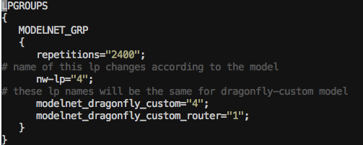
Configuring dragonfly network model
nw-lp is a simulated MPI process
A simulated dragonfly network node
A simulated dragonfly network router
For simulating multiple MPI processes per node → nw-lp=num-procs * number of network nodes
Self messages→ messages sent to the same network node
Overhead for sending self message can be configured
Configuration file can be found in codes/src/network-workloads/dragonfly-custom

Slide 23
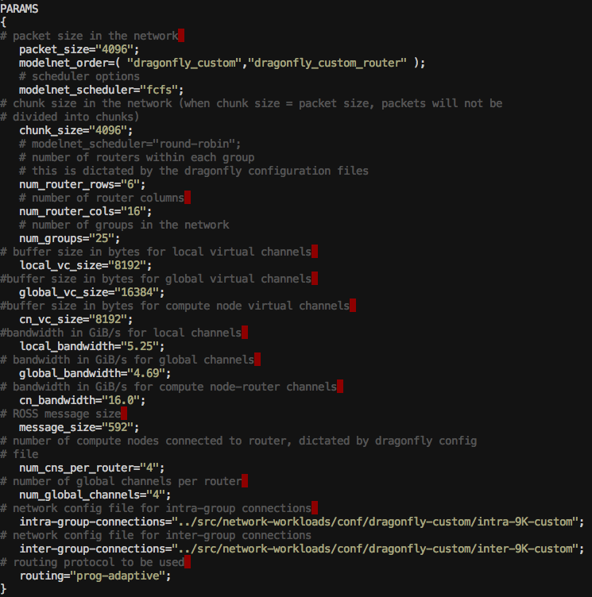
Configuring dragonfly network model
Router arrangement within a group. Should match the input network configuration
Buffer size of virtual channels can be configured
Number of compute nodes per router is configurable
Network configuration files – can be custom generated (see scripts/gen-cray-topo/README.txt).

Slide 24
Running a dragonfly network simulation
Download the traces:
wget https://portal.nersc.gov/project/CAL/doe-miniapps-mpi-traces/AMG/df_AMG_n1728_dumpi.tar.gz
Run the simulation:
./src/network-workloads/model-net-mpi-replay --sync=1 --disable_compute=1 --workload_type="dumpi" --workload_file=df_AMG_n1728_dumpi/dumpi-2014.03.03.14.55.50- --num_net_traces=1728 -- ../src/network-workloads/conf/dragonfly-custom/modelnet-test-dragonfly-edison.conf

Slide 25
Fat tree network model
Can simulate two and three level fat tree networks
Width of the tree (number of pods) can also be configured
Two forms of routing are supported:
static: uses destination-based look-up tables
adaptive: selects least congested output port
Packet based simulation with credit based flow control
Full 3-level k=8 Fat-Tree with 128 compute nodes

Slide 26
Fat Tree Network Configurations
Tapering can be used to connect more nodes to the leaf switches
Reduces the bandwidth, switches and links at higher level
To get higher bandwidth, nodes can connect to multiple ports (multi-rail) in one or more plane (multi-plane)
These configurations can also be tapered to reduce switches, links at higher levels
Model supports configurations for multiple rails, multiple plane and tapering

Slide 27
Configuring fat tree network model
Nw-lp is a simulated MPI process
A simulated fat tree network node
Three simulated fat tree network switches (one in each level of the network)

Slide 28
Configuring fat tree network model
Switch arrangement should match the input network configuration
Switch radix can be configured
Static routing requires precomputed destination routing tables
See:
https://github.com/codes-org/codes/wiki/codes-fattree#enabling-static-routing

Slide 29
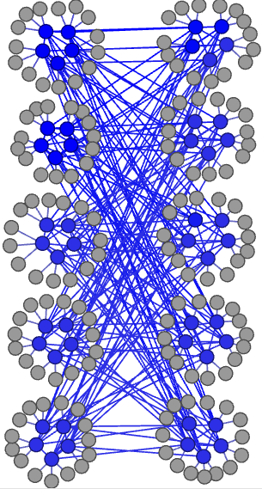
Slim fly network model
Topology of interconnected router groups built with MMS graphs
The max network diameter is always 2
Packet based simulation with credit based flow control
Multiple forms of routing are supported:
minimal: 2 virtual channels
non-minimal: 4 virtual channels
adaptive: 4 virtual channels
Fig. Slim Fly with q=5
Notes:
The two generator sets are the two sets of indices used to calculate connections between routers in the same subgraph.
The computation of generator sets is very non-trivial and it hasn’t been automated so far.
The two subgraphs span half the groups. The entire network of routers is logically broken into two subgraphs. Within each subgraph, routers are broken into groups.

Slide 30
Configuring Slim Fly network model
Router arrangement within a group.
Generator sets are set of indices used to calculate connections between routers in the same subgraph. They must be precomputed.

Slide 31
HYPER-X, Express mesh, and Torus
Express Mesh: low-diameter densely connected grids
Allows for specifying connection gap
Gap = 1 -> HyperX
Torus: based on a n-dimensional k-ary network topology
Number of torus dimensions and length of each dimension can be configured
Supports dimension order routing
Uses bubble escape virtual channel for deadlock prevention
Notes:
- Used in Blue Gene and Cray XE and XT series of networks

Slide 32
Arbitrary graphs
Can also input arbitrarily connected graphs
Defined using DOT format
Static routing is required
Generated using OpenSM, courtesy Jens Domke

Slide 33
Interpreting simulation output

Slide 34
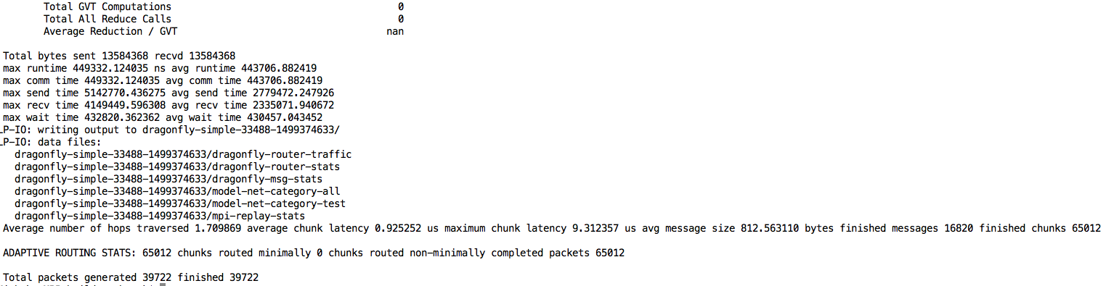
Interpreting simulation output
Application level statistics e.g. time spent in overall execution, communication, wait operations, amount of data transferred etc.
Enabling lp-io-dir generates detailed network statistics files
Average and maximum times are reported for all the application runs
Network statistics (hops traversed, latency, routing etc.) are reported for the entire network
Detailed statistics for each MPI rank, network node, router, port are generated using lp-io-dir option
--lp-io-dir=my-dir can be used to enable statistics generation (Each lp writes it statistics to a summary file)

Slide 35
Statistics reported by lp-io
Dragonfly-msg-stats:
number of hops, packet latency, packets sent/received, link saturation time reported for each network node
Dragonfly-router-stats
link saturation time each router port
Dragonfly-router-traffic
Traffic sent for each router port
Fat tree and slim fly networks have similar statistics files.
Mpi-replay-stats (generated for any network model):
bytes sent/received per MPI process
time spent in communication per MPI process
Number of sends and receives per MPI process

Slide 36
Case study
Fit Fly: Interconnect Innovation through parallel simulation

Slide 37
CODES is designed to help find answers to the “What If…” type questions in HPC Interconnection research

Slide 38
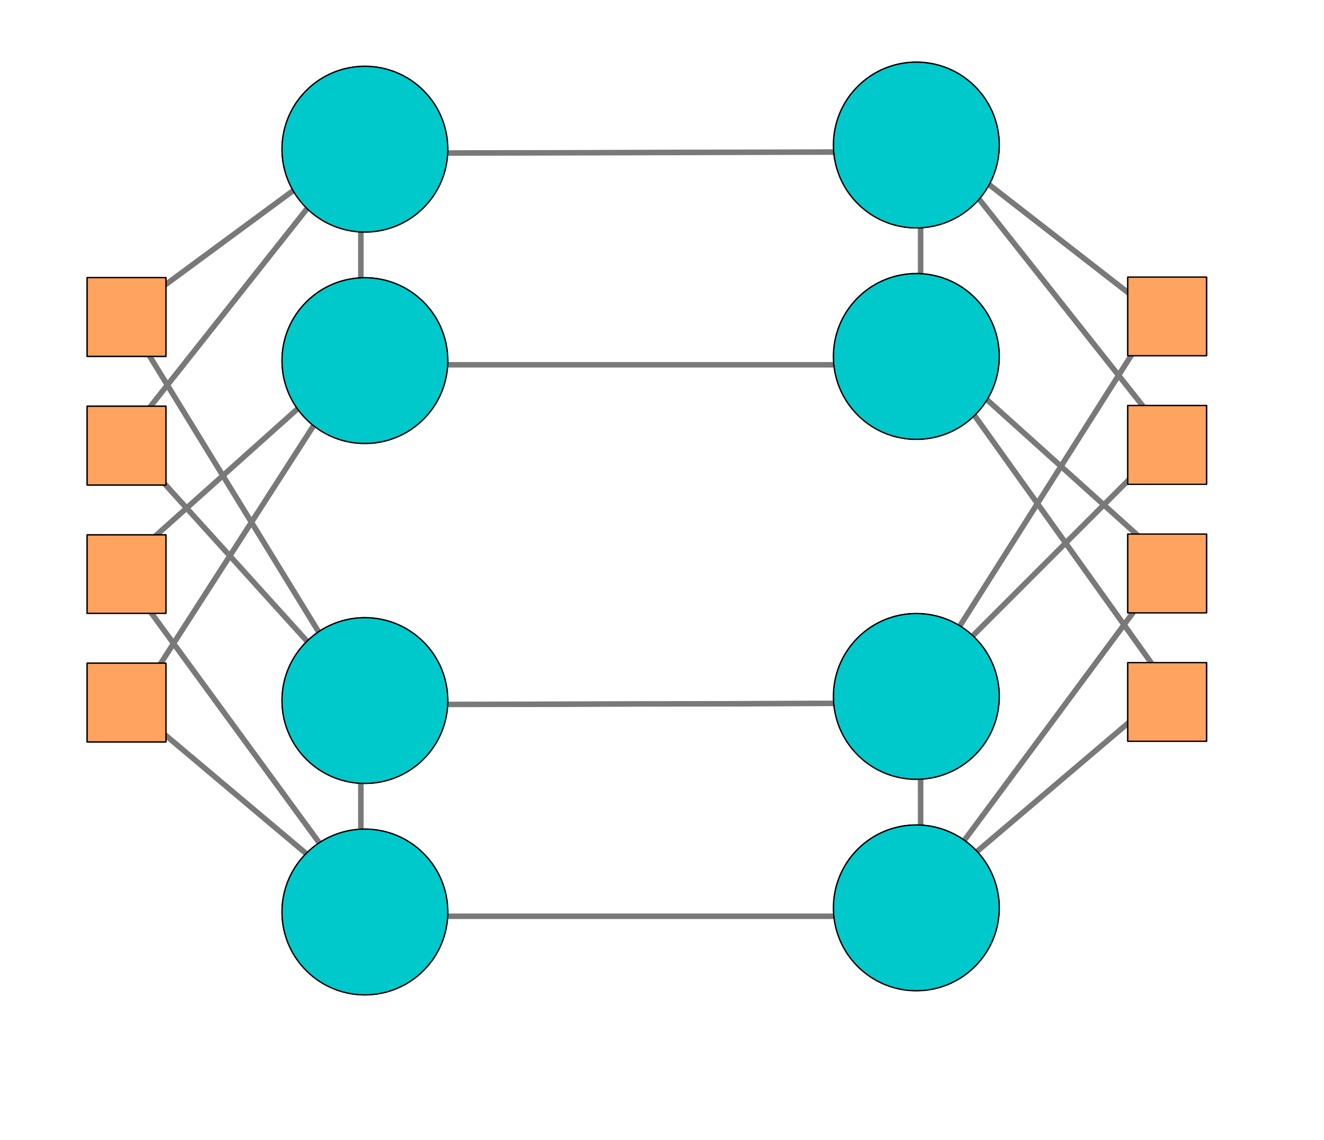
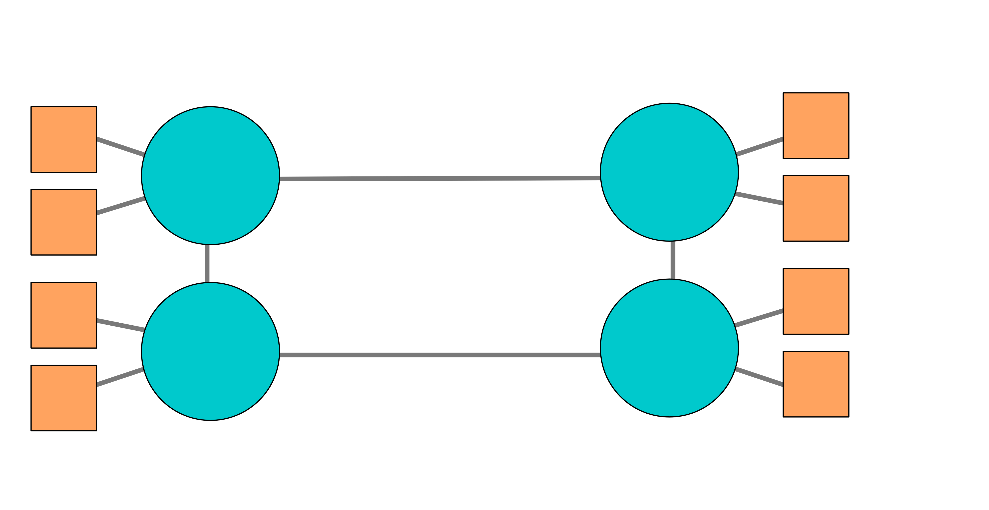
MultI-Plane Networks
Hand in hand with multi-rail networks
Additional links for packet injection
Additional independent planes of routers
Often sharing terminals across planes
Single Plane
Dual Plane

Slide 39
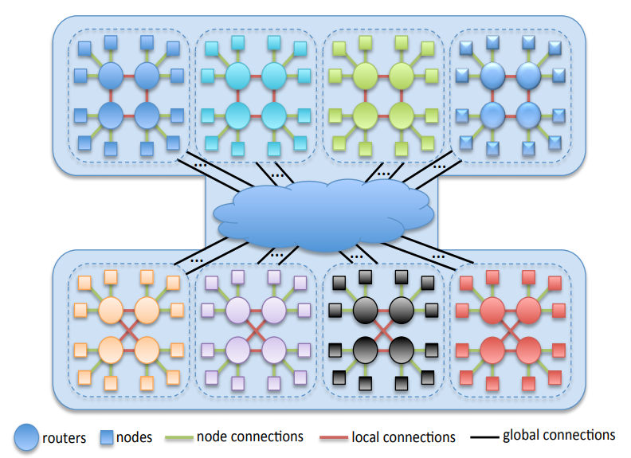
Slim Fly Network Topology
Routers in network are organized into groups
Each Router
Some degree of Local connectivity
Some degree of Global connectivity
Some degree of Terminal connectivity
Guaranteed Diameter-2
Groups are divided into two subgraphs
No global connections between two groups within same subgraph
Connections are determined via non-trivial generation method
Makes it challenging to physically build

Slide 40
Fit Fly
Multi-Planar Slim Fly Network
Planes share single set of terminals
Each plane follows same Slim Fly network generation method
Terminal to Router mapping is alternating mirrored on each new plane
Increase path diversity
Slim Fly
Fit Fly

Slide 41
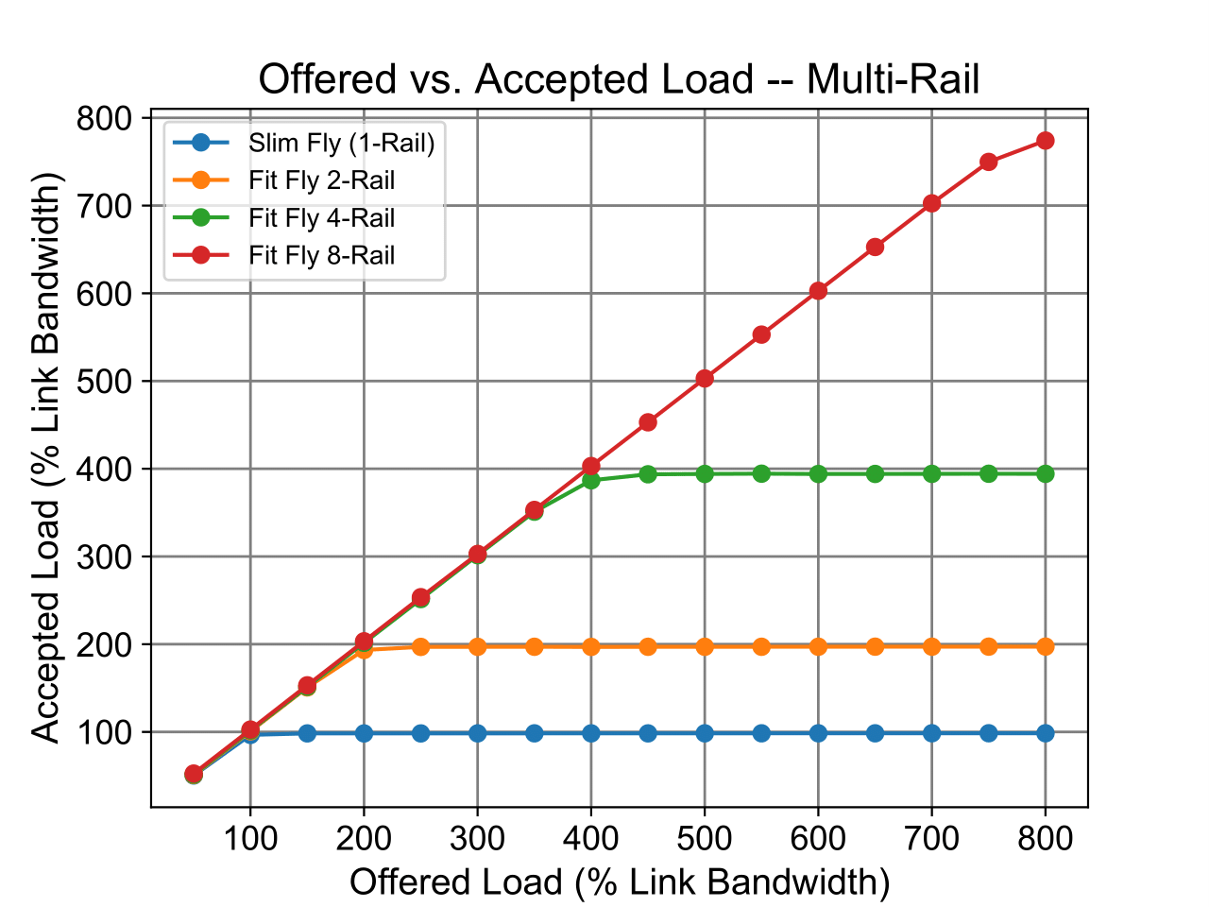
More Rails = More Throughput
Fit Fly Based on previously validated Slim Fly Model
Additional planes bring additional throughput
Observed expected increase in throughput with synthetic uniform random traffic

Slide 42
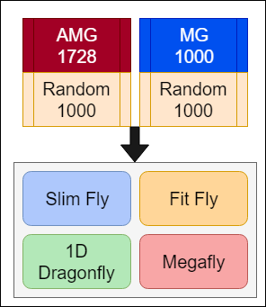
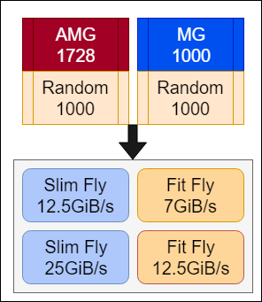
Experiments overview
Experiment Set 1
Cross Network
Experiment Set 2
Equalized Bandwidth

Slide 43
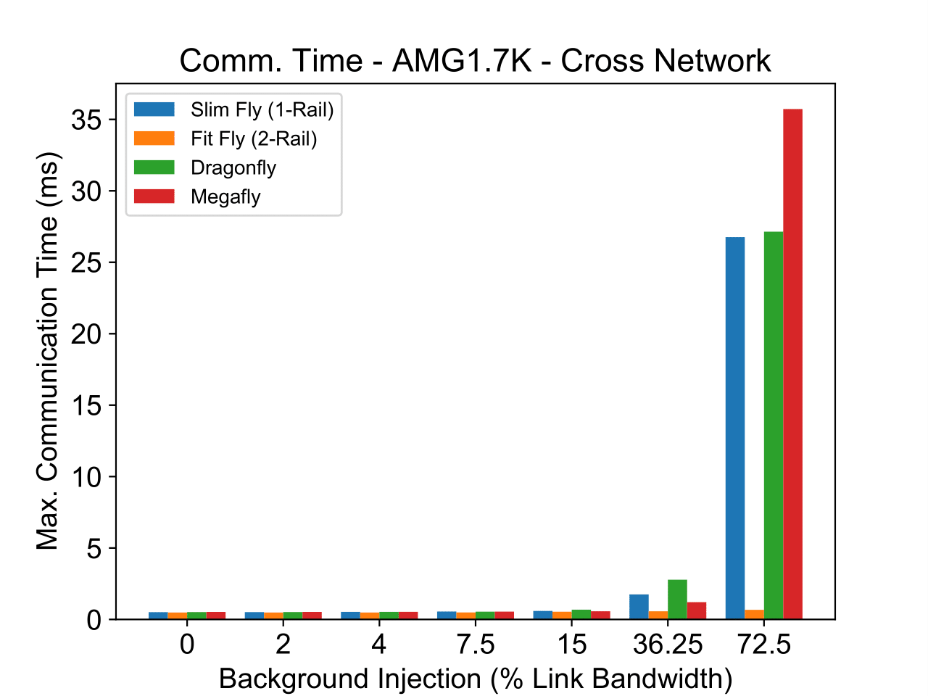
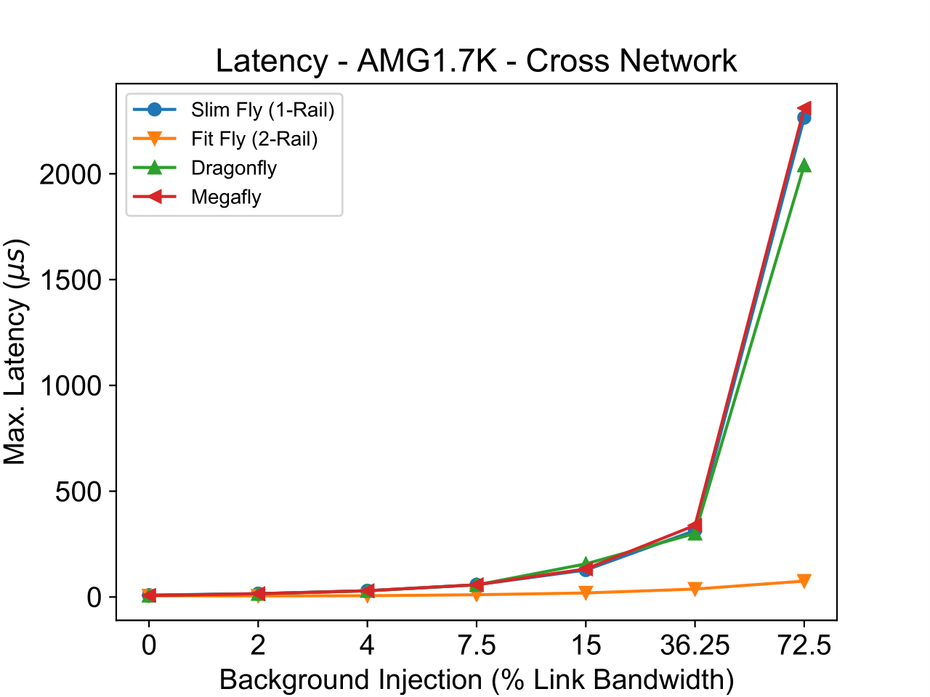
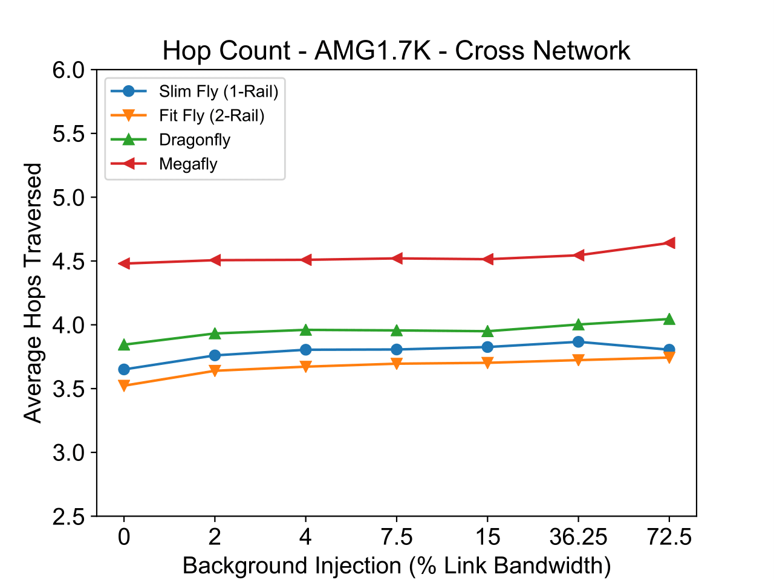
Network Comparison: AMG 1728
Lower is better

Slide 44
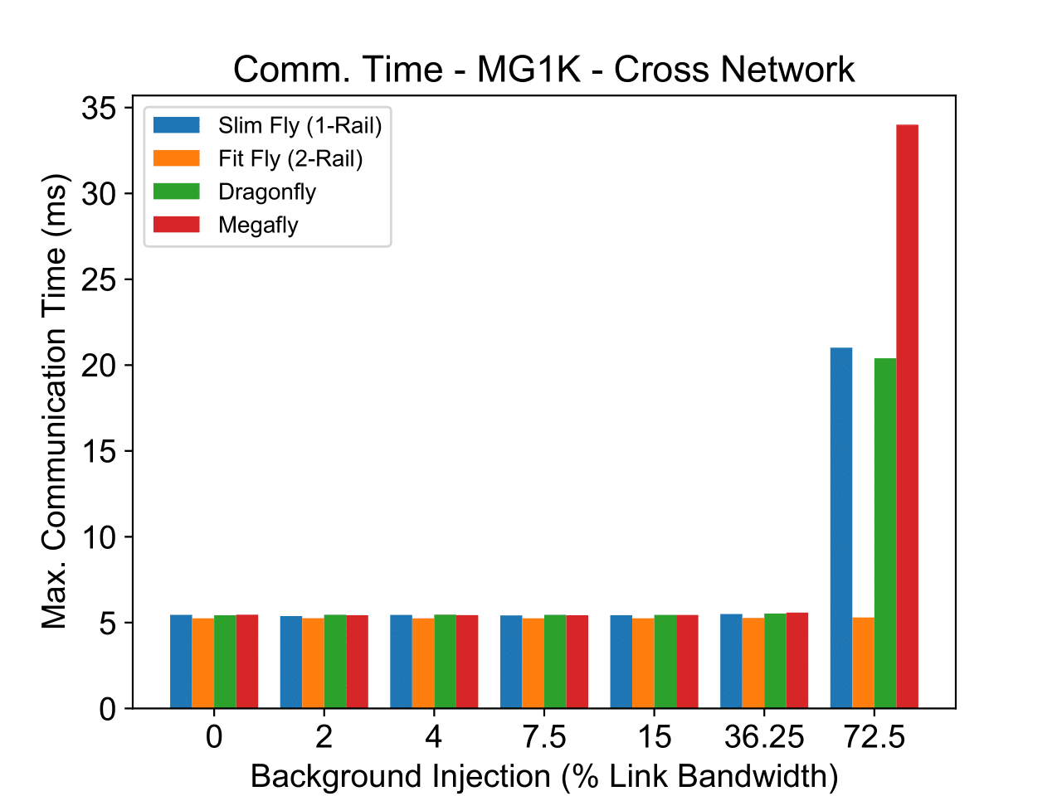
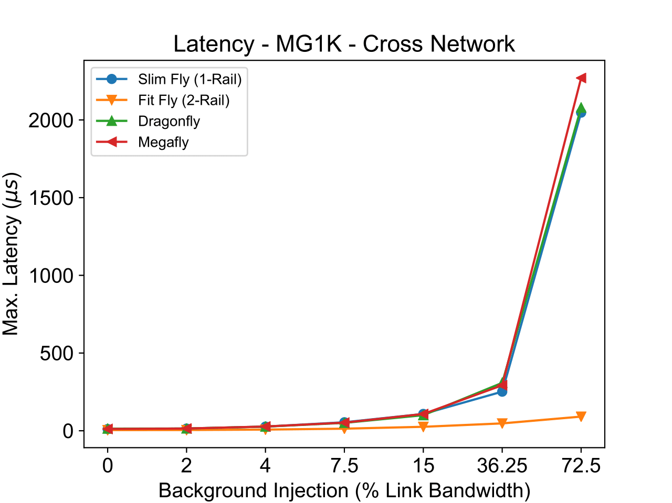
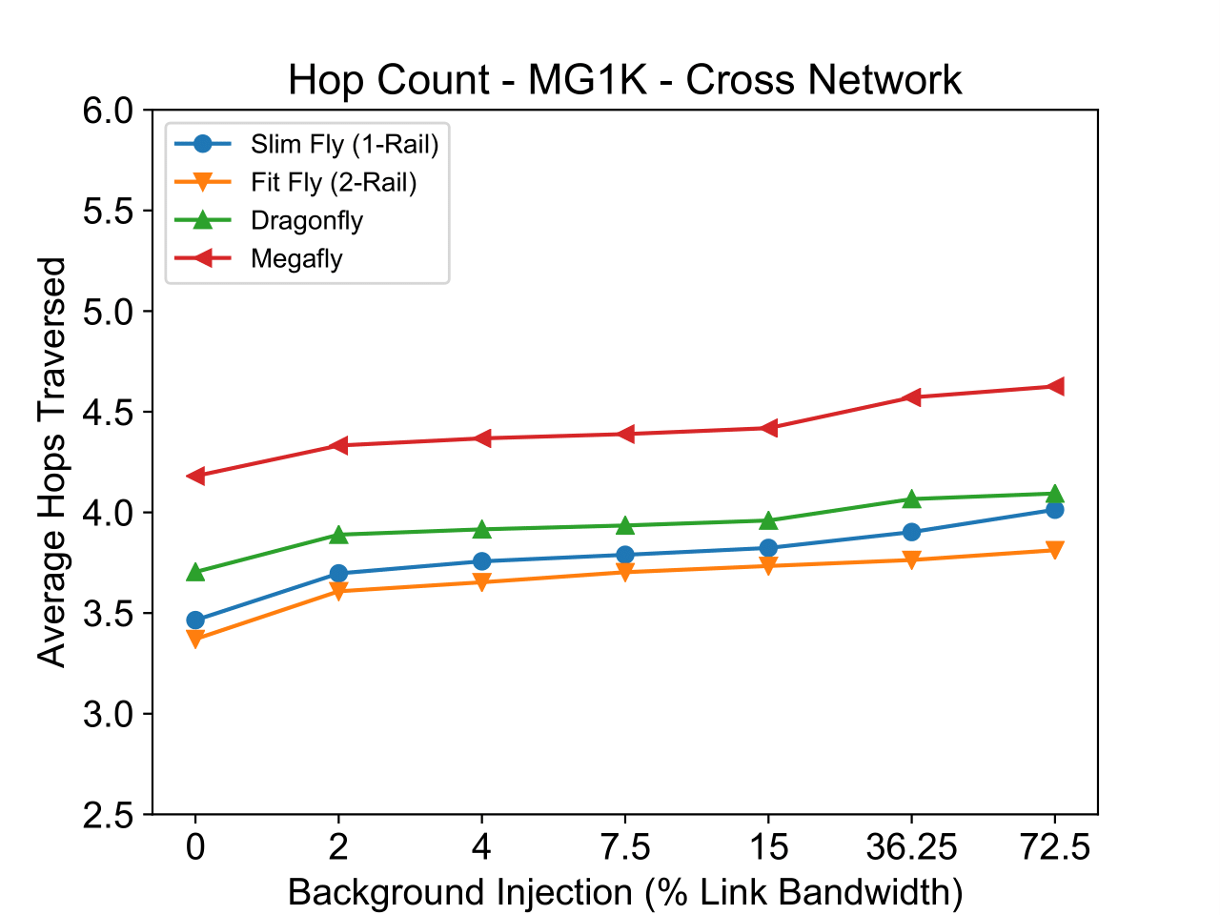
Network Comparison: MG 1000
Lower is better

Slide 45
Discussion: Network Comparison
Slim Fly performed well against state of the art Dragonfly and Megafly networks
Possible future exascale networks
Fit Fly showed great resilience to high levels of interference traffic
Beat Slim Fly by an order of magnitude
Slim Fly and Fit Fly networks show great promise
Low-diameter-high-path-diversity

Slide 46
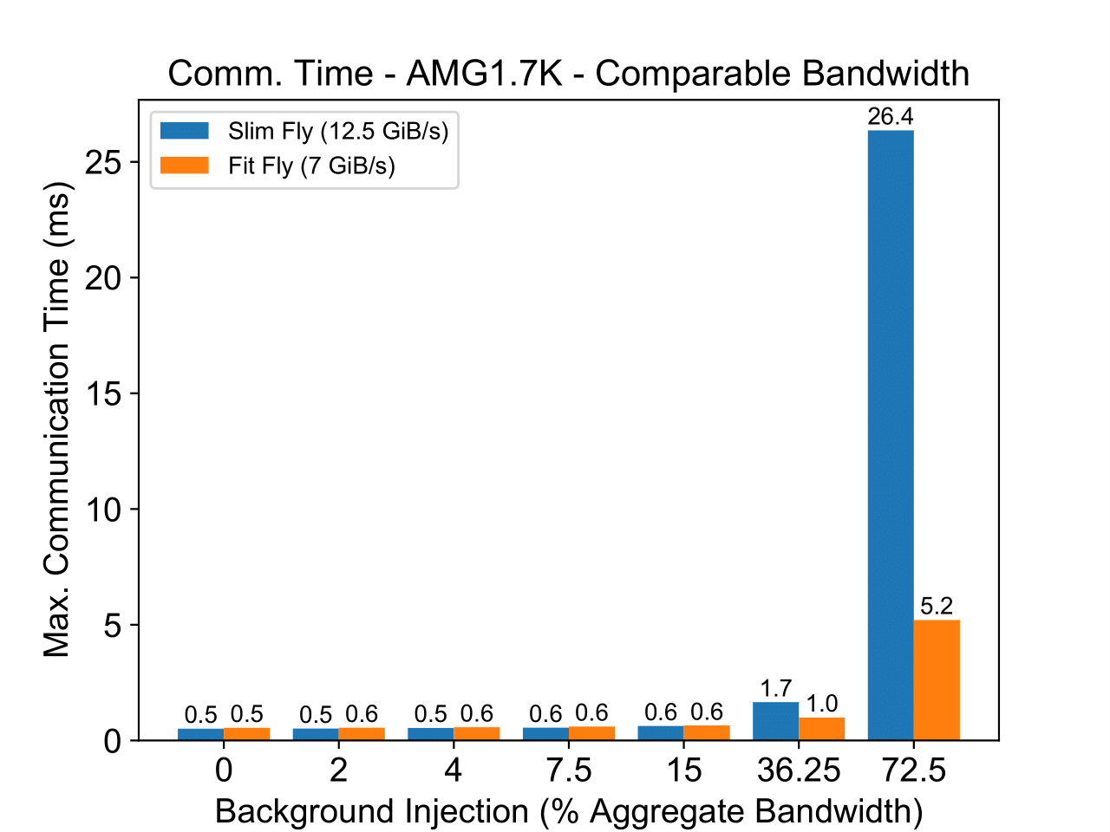
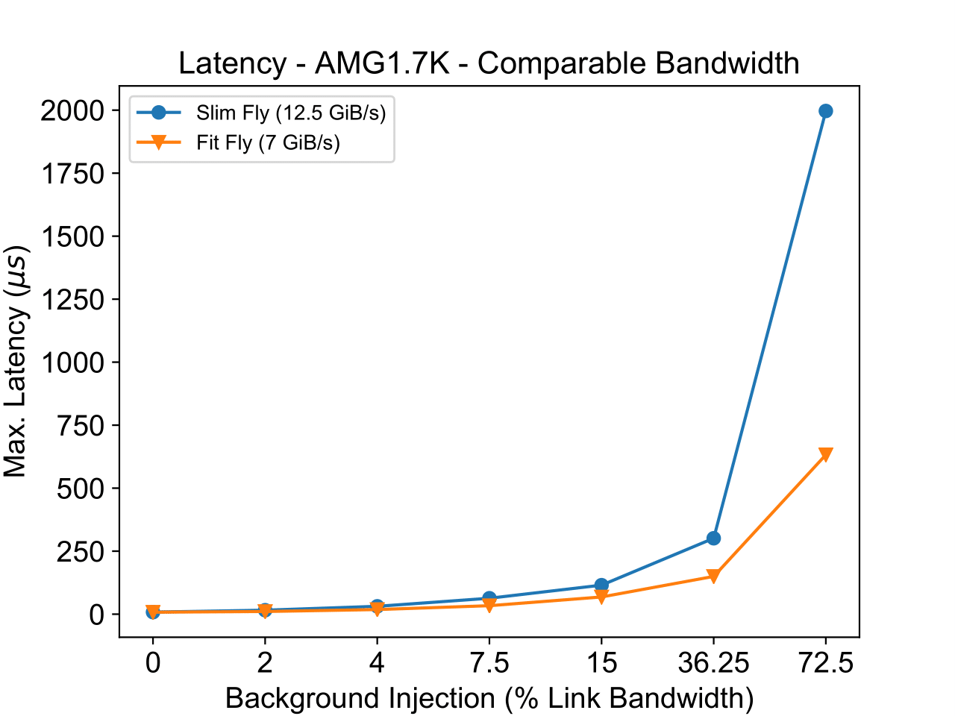
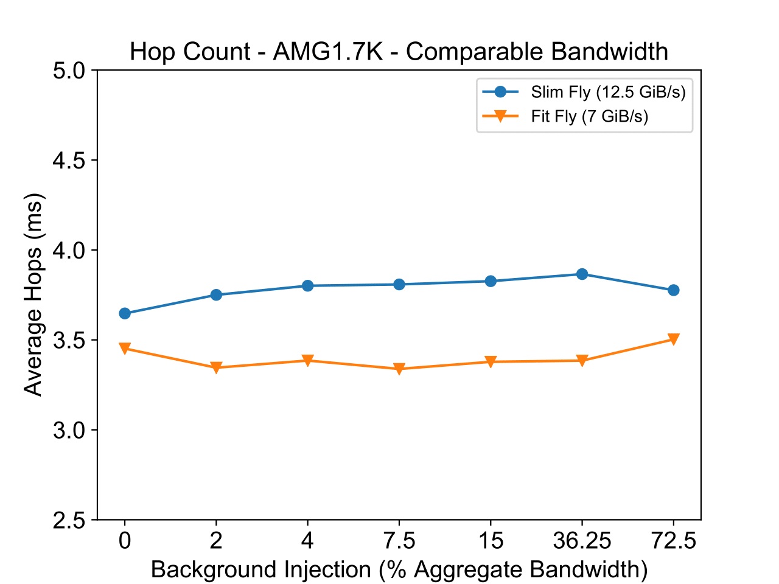
Equalized Bandwidth 12.5GiB/s – AMG 1728
Lower is better

Slide 47
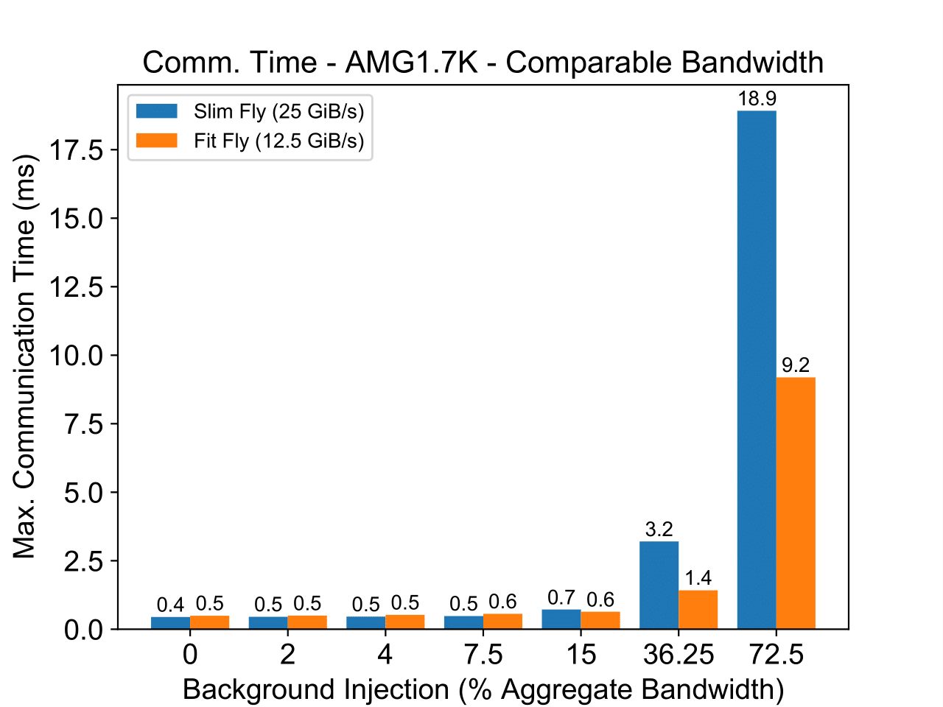
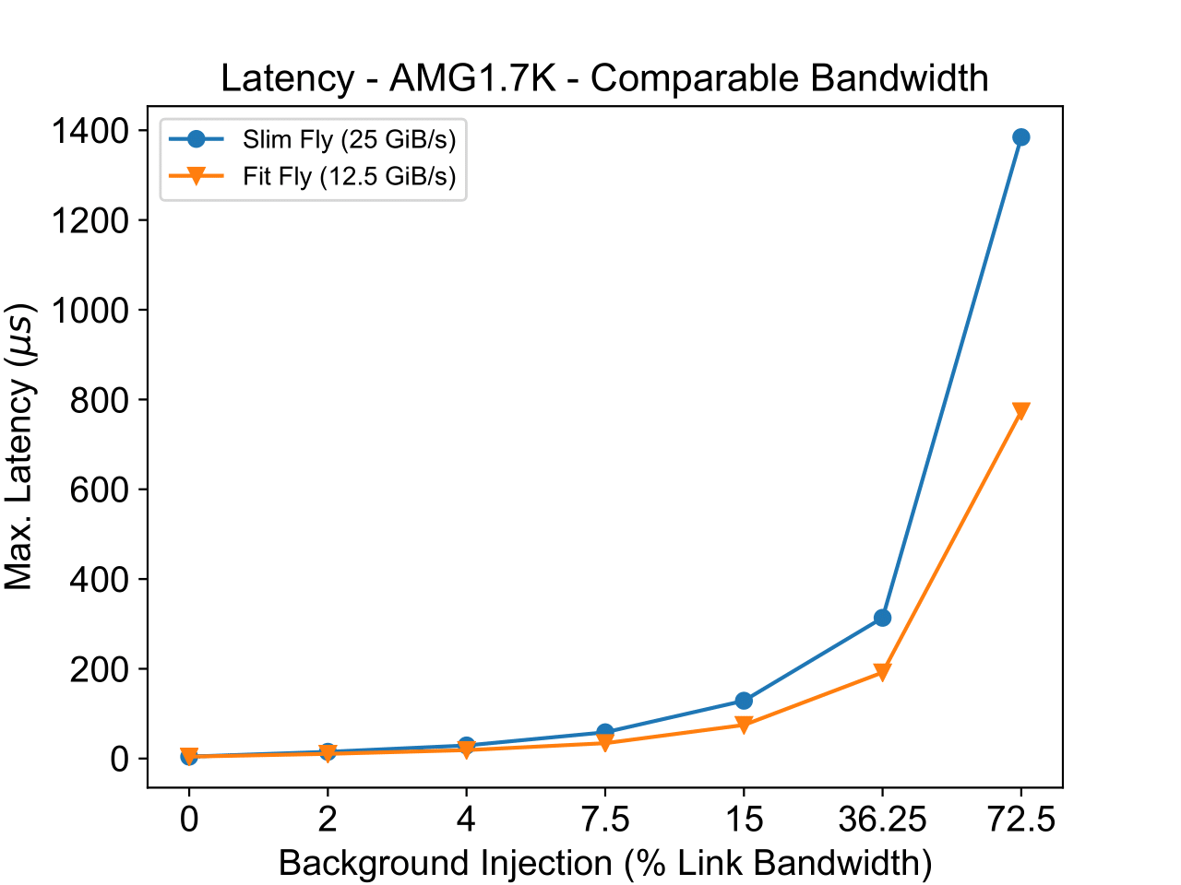
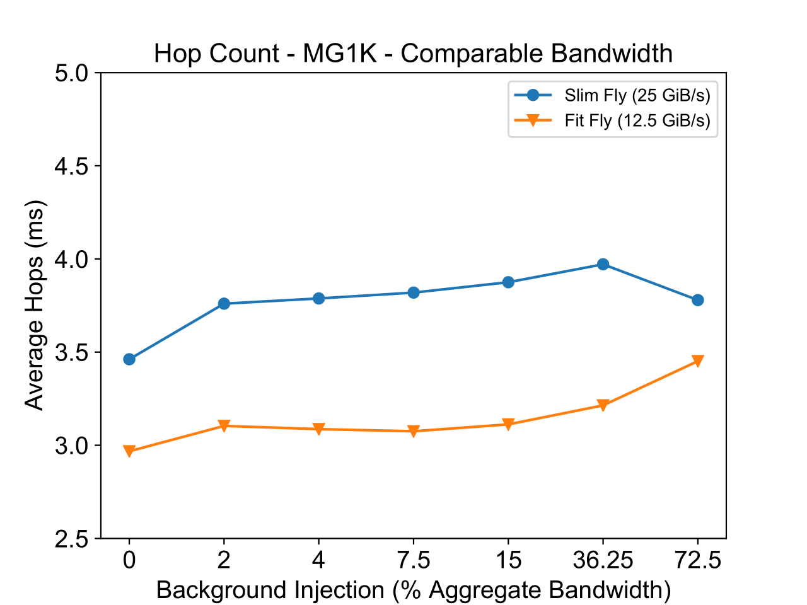
Equalized Bandwidth 25GiB/s – AMG 1728
Lower is better

Slide 48
Discussion: Equalized Bandwidth
Equalizing the aggregate bandwidth across networks slightly reduced the advantage that Fit Fly had
Fit Fly still pulled ahead
Greater interference resilience
Additional planes of routers give less chance for any two packets to interact
Less interference
Less buffer wait time
Increased Application Performance
More planes of cheaper routers may be a better option to single-plane-high-bandwidth networks

Slide 49
Case Study: Conclusion
Fit Fly well outperforms state-of-the-art interconnects
More routers and planes = Less Interference
More routers = More Cost
But cheaper routers and links could be used
CODES provides a strong environment for answering “What If…” questions and fostering future innovation in the field of HPC interconnection networks

Slide 50
Running interconnect simulations
Checkout the exercises at the wiki link:
https://github.com/codes-org/codes/wiki/quick-start-interconnects

Slide 51
Session II: Application simulation, workloads, MPI

Slide 52
Four steps TO SIMULATIONS
Prototype system design
Discussed in the previous session
Set up using network parameters
Workload selection
Depends on the use case
Application traces
Synthetic patterns
Skeletons
Workload creation
Execution

Slide 53
Simulation Suite
HPC Application Traces
MPI replay
Network Simulation
Network Model statistics
General framework for replaying traces on HPC interconnect simulation
CODES specific framework for replaying traces on HPC interconnect simulations
Notes:
TODO: Animate the figure parts

Slide 54
workloads
Synthetic Workloads:
Follow specific communication pattern and a constant injection rate
Often used to stress the network topology to identify best and worst case performance
Examples include uniform random, all to all, bisection pairing, bit permutation
Don’t require simulation of MPI operations
HPC Application Traces:
Useful for network performance prediction of production HPC applications
Trace size can be large for long running or communication intensive applications
Potential to capture computation-communication interplay
Require accurate simulation of MPI operations
Simulation results can be complex to analyze
Intel SWM Online Workloads:
Accurate workload representations
Decoupled from original application
Portable to arbitrary simulation environments
Generates traffic on-the-fly
Notes:
- TODO cite WSC paper here

Slide 55
DUMPI mpi trace library
Provides trace collection and replay tools for MPI based applications
Trace collection is simple – link the MPI application with libdumpi
Trace can be replayed using libundumpi utility
Libundumpi provides callbacks you can use when MPI operations are replayed
Preserves the causality order of MPI operations
Captures detailed statistics for each MPI operation call

Slide 56
Capturing application traces with dumpi
Repository can be cloned at:
git clone https://github.com/sstsimulator/sst-dumpi.git
Configure and build using any MPI compiler
Make sure to use ‘—enable-libdumpi’ when configuring
Once installed, simply add ‘-L$(DUMPI_INSTALL) -ldumpi’ in your application
DUMPI traces will be generated automatically with each application run
Naming convention: dumpi-yyyy.dd.mm.hh.mm.ss-MPI-RANK-ID.bin
More information can be found at: https://github.com/sstsimulator/sst-dumpi
HPC application traces in DUMPI format: https://portal.nersc.gov/project/CAL/designforward.htm

Slide 57
Generating OTF2 traces (1/2)
New Open Trace Format version 2 is supported by several tools
ScoreP - Scalable Performance Measurement Infrastructure for Parallel Codes
Tool suite with several libraries and helper tools
http://www.vi-hps.org/projects/score-p/
Inside ScoreP source directory
CC=mpicc CFLAGS="-O2" CXX=mpicxx CXXFLAGS="-O2" FC=mpif90 F77=mpif77 ./configure --without-gui --prefix=<SCOREP_INSTALL>
make && make install
Make sure ScoreP installation’s bin directory is in PATH
Simple case: change the application linker to LD = scorep --user --nocompiler --noopenmp --nopomp --nocuda --noopenacc --noopencl --nomemory <your_linker>

Slide 58
Generating OTF2 traces (2/2)
Before running, set the following environment variables: export SCOREP_ENABLE_TRACING=1 export SCOREP_ENABLE_PROFILING=0 export SCOREP_MPI_ENABLE_GROUPS=ENV,P2P,COLL,XNONBLOCK
Turning tracing on/off: make sure these calls are synchronized
#include <scorep/SCOREP_User.h>
SCOREP_RECORDING_ON(); - start recoding
SCOREP_RECORDING_OFF(); - stop recording
During compilation, add flags: -I$SCOREP_INSTALL/include -I$SCOREP_INSTALL/include/scorep -DSCOREP_USER_ENABLE
Trace target options export SCOREP_TOTAL_MEMORY=256M export SCOREP_EXPERIMENT_DIRECTORY=/p/lscratchd/<username>/...

Slide 59
Tracing output
scorep-* directory generated with following content: scorep.cfg traces traces.def traces.otf2
scorep.cfg is human readable; can be used to verify if the environment is correctly generated
traces.otf2 is a binary meta-file
traces is a directory that contains the details
Use otf2-print utility in ScoreP bin to view the traces: otf2-print –L 0 traces.otf2

Slide 60
Information captured in a typical trace (e.g. in DUMPI, OTF2)
Time stamp, t (rounded off) | Operation type | Operation data (only critical information is highlighted)
t = 10 | MPI_Bcast | root, size of bcast, communicator
t = 10.5 | MPI_Irecv | source, tag, communicator, req ID
t = 10.51 | user_computation | optional region name - “boundary updates”
t = 12.51 | MPI_Isend | dest, tag, communicator, req ID
t = 12.53 | user_computation | optional region name - “core updates”
t = 22.53 | MPI_Waitall | req IDs
t = 25 | MPI_Barrier | communicator

Slide 61
Example to show the effect of replaying traces
Original Time stamps | Original duration | New Time stamps | New duration | Operation type
10 | 0.5 | 10 | 0.2 | MPI_Bcast
10.5 | 0.01 | 10.2 | 0.01 | MPI_Irecv
10.51 | 2 | 10.21 | 2 | user_computation
12.51 | 0.02 | 12.21 | 0.02 | MPI_Isend
12.53 | 10 | 12.23 | 10 | user_computation
22.53 | 2.47 | 22.23 | 0.03 | MPI_Waitall
25 | 1 | 22.26 | 1.7 | MPI_Barrier
Notes:
TODO Nikhil: Explain in caption what the red color coding means.

Slide 62
DUMPI vs OTF2
Most of the information in the trace format is the same
Different w.r.t. capturing of dynamically determined events: e.g. MPI_Waitany
DUMPI: stores all the information passed to the MPI call
Simulation decides which request to fulfill: accurate resolution for target systems
If the control flow of the program can change significantly due to the ordering of operations, simulations are not entirely correct
OTF2: stores only the information that is used (e.g. which request was satisfied)
Accurately mimics the control flow of the trace run
But does not accurately represent execution for the target system
Artifact of leveraging existing tools not originally intended for PDES!
Notes:
A different system could capture both and allow PDES to decide which/hoe to use.

Slide 63
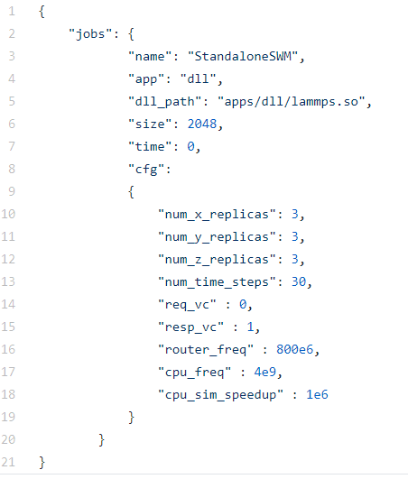
Intel SWM Workloads
Open Source version hosted at https://github.com/codes-org/SWM-workloads
Built separately: a CODES-SWM interface has been developed
Includes several workloads including LAMMPS, Nekbone, Nearest Neighbor, HACC, MILC, Incast, Point-to-Point
Each workload is configured by its own JSON configuration file
Specifies size
More CODES use information:
https://github.com/codes-org/codes/wiki/online-workloads

Slide 64
Simulating mpi

Slide 65
MPI Simulation
Matching semantics and standard has to be followed for a correct simulation
So obviously done
Eager – Rendezvous protocol
Cutoff can be specified in the config
Library call overheads handled using a constant cost
Collectives:
OTF2 based simulations implements them internally
DUMPI based simulations use Cortex

Slide 66
Translating mpi calls using cortex
Internally most MPI implementations support collectives by translating into point to point
Cortex comes with a set of translation functions to convert collectives into point to point using MPICH algorithms
When linked with DUMPI and CODES, Cortex translates MPI collectives into point to point sends/receives (simulated by CODES)
Cortex can also be used to implement your own translation functions (e.g. collective algorithms)
Cortex tutorial is available at : https://xgitlab.cels.anl.gov/mdorier/dumpi-cortex/wikis/home

Slide 67
codes, cortex and dumpi interaction
MPI send/recv/waits
CODES
DUMPI Application Trace
MPI Simulation Layer
MPI Collective calls
Translated sends/recvs
Cortex
Model-net layer
Network Models

Slide 68
mpi translation with cortex
To enable collective translation, install Cortex and reconfigure CODES with Cortex
Cortex available for download: git clone https://xgitlab.cels.anl.gov/mdorier/dumpi-cortex.git
cmake .. -G "Unix Makefiles" -DMPICH_FORWARD:BOOL=TRUE -DCMAKE_INSTALL_PREFIX=$HOME/CODES/install/cortex -DDUMPI_ROOT=$HOME/CODES/install/dumpi
See instructions at: https://xgitlab.cels.anl.gov/codes/codes/wikis/codes-cortex-install
Use –with-cortex=/path/to/cortex/install option
Notes:
Uses a similar API as DUMPI but you don’t need to specify callbacks for all the MPI functions
In CODES, there are similar callback functions that simulate MPI operations like send, receive, wait
For collective operations, CODES calls Cortex callbacks that translate collectives into point to point

Slide 69
In a nutshell: Replaying a single application trace
./bin/model-net-mpi-replay --sync=1 --disable_compute=1 --workload_type="dumpi" --workload_file=dumpi-2014.03.03.14.55.50- --num_net_traces=1728 -- modelnet-test-dragonfly-edison.conf
Runtime options
--workload_type: “dumpi” or “online” for SWM
--num_net_traces : Number of input network traces
--workload_file: DUMPI trace file
Network configuration file: Any of the network files (number of simulated ranks > number of ranks in trace)
--lp-io-dir (optional): Generates detailed network counters and statistics
--lp-io-use-suffix (optional): Generates a unique directory per run
--disable_compute (optional): disable any compute time between MPI events
--workload_conf_file: for SWM, specifies name of workload to be used
For running parallel simulations, use mpirun and –sync=3
Notes:
MOVE it after setup

Slide 70
Simulating multiple jobs on the network

Slide 71
Replaying multiple jobs
./src/network-workloads/model-net-mpi-replay --sync=1 --disable_compute=1 --workload_type="dumpi" --workload_conf_file=multiple-workloads.conf –alloc_fil -- modelnet-mpi-test-dragonfly.conf
For multiple jobs, two of the arguments are different:
Workload_file: Has information on the dumpi/SWM traces for each application
Alloc_file: List of simulated MPI ranks to be assigned to each job

Slide 72
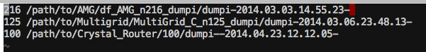
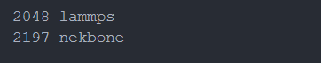
Example workload file
Left column: Number of application ranks per job
Right column: Path and prefix of DUMPI traces for each job – or name of SWM
Combination SWM and Dumpi slated for future
Currently can only combine DUMPI+DUMPI/Synthetic and SWM+SWM/Synthetic

Slide 73
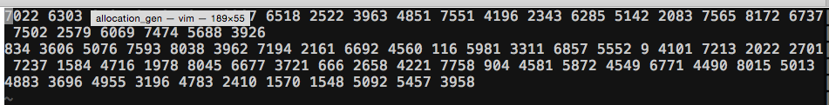
Example job allocation file
List of MPI ranks for each job
There is a job entry per line
Example at the top shows job placement being done in a linear scheme
Example below shows job placement in a random fashion (assumes one rank per node).

Slide 74
Generating job allocations using different schemes
Multiple schemes to map jobs onto the network
Randomly selected nodes
Contiguous or linear
Randomly selected switches (ranks ordered on nodes attached to a switch)
Clustered placement
…
Scripts can be used to generate job allocation files with any of the above schemes
CODES keeps track of the job ID and provides it in simulation output
Some python scripts can be found in scripts/allocation_gen

Slide 75
Session iii: storage models and synthetic traffic generation

Slide 76
Goals of the session
How to do storage placement on networks?
How to generate background network traffic?
Using model-net API
PDES and Networks Internal
Continue with hands on exercises

Slide 77
Storage placement on interconnects

Slide 78
Storage placement on hpc systems
Example burst buffer placement on a Blue Gene system
Example burst buffer placement on a dragonfly system
* Image credit: On the role of burst buffers in Leadership class storage system by N. Liu et al. in MSST 2012

Slide 79
Modeling burst buffer with codes
General purpose model for read and write operations
Concurrent, pipelined RDMA requests
Comprises of the following:
a storage manager
a disk/local storage model
A resource tracker
Placement of storage over the network can be modified using the network config file

Slide 80
Protocol for write operations

Slide 81
Using the storage model
codes_store_init_req (is_write, priority, obj_id, xfer_offset, xfer_size, codes_req) → For initializing the request
codes_store_send_req(codes_req, dest_id, sender, network_id, mapping_context, ..) → For sending the request
codes_store_send_req_rc → For reverse computation
Repo available at:https://xgitlab.cels.anl.gov/codes/codes-storage-server

Slide 82
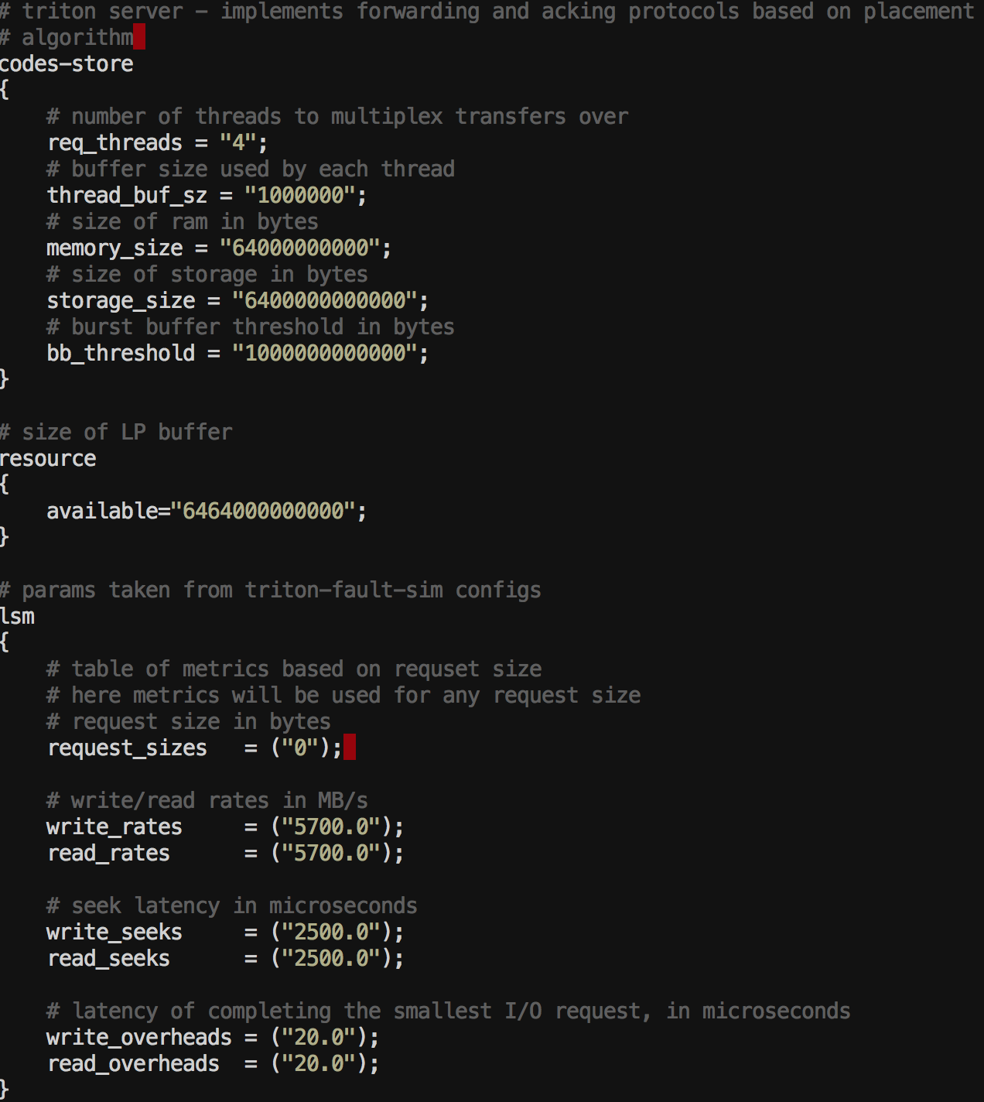
Configuring storage over the network
Number of concurrent requests
Buffer size for each thread
Size of the Memory (RAM)
Storage size (for disk/LSM)
Aggregate memory+storage size
Disk bandwidth/seek configuration

Slide 83
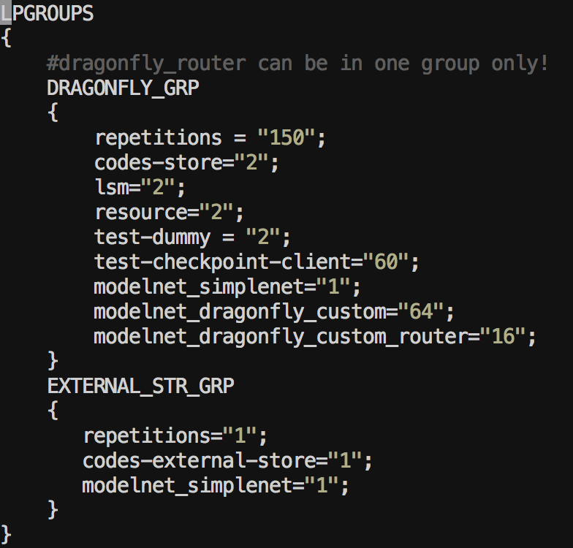
Configuring storage over the network
Two storage manager entities per 60 clients/compute nodes (Cray Cori configuration)
Local storage model entity (disk). One to one correspondence
Dummy nodes are to balance
node to router ratio for BB routers
A total of 64 network nodes
If the data from burst buffer needs to be drained to the external storage entity

Slide 84
Generating background network traffic

Slide 85
Why background traffic?
On production HPC systems, a significant fraction of network nodes can be occupied
How to introduce communication interference if a single application trace is being replayed on the simulation?
Running multiple traces at a large-scale can be expensive
One solution is to mix synthetic traffic patterns and HPC application traces

Slide 86
Example Synthetic patterns
Uniform Random: A network node is equally likely to send to any other network node (traffic distributed throughout the network)
All to All: Each network node communicates with all other network nodes
Nearest neighbor: A network node communicates with near by network nodes (or the ones that are at minimal number of hops)
Permutation traffic: Source node sends all traffic to a single destination based on a permutation matrix
Bisection pairing: Node 0 communicates with Node ‘n’, node 1 with ‘n-1’ and so on.
…

Slide 87
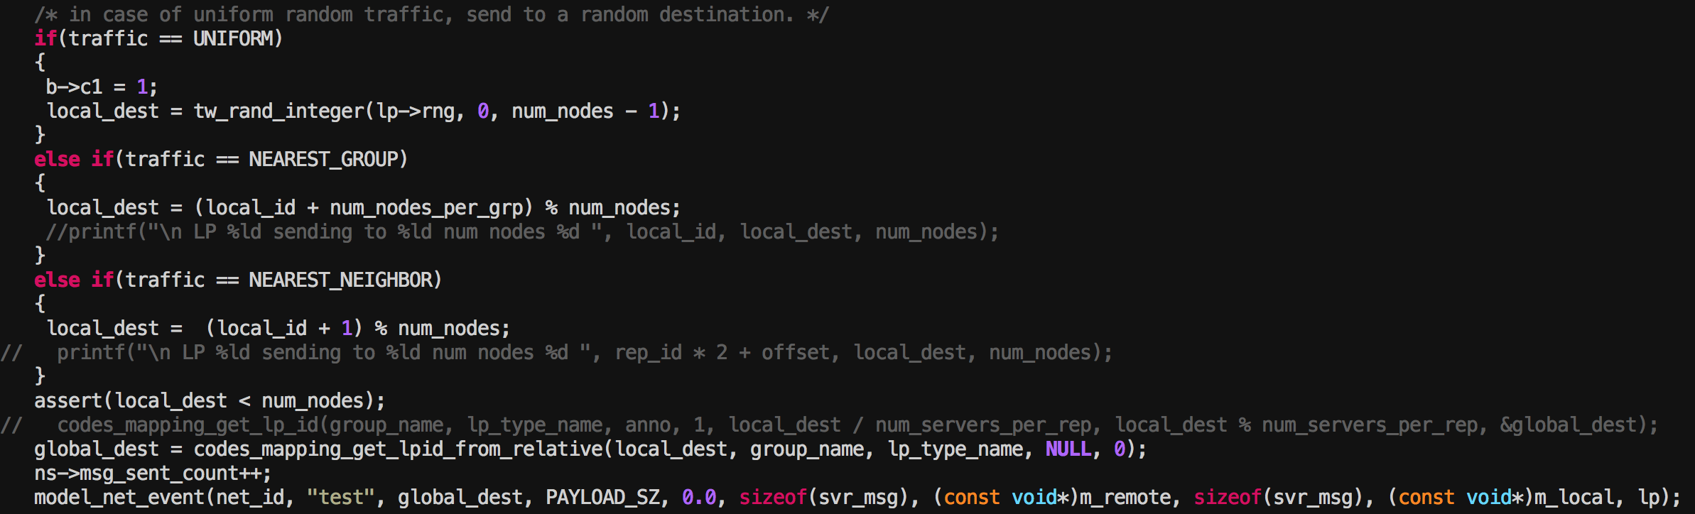
Synthetic traffic in codes
* Code snippet from synthetic workload generator
Typical patterns supported are uniform random and nearest neighbor.
All to all and stencil patterns have been tested (pending integration)
See src/network-workloads/model-net-synthetic-custom-dfly.c and related files

Slide 88
Generating background traffic with codes
Communication based on uniform random traffic
Kicks off when the main workload starts
A notification is sent to the background traffic node to stop generating traffic once the main workload finishes
How to enable synthetic traffic generation?
Simply add “synthetic” instead of DUMPI trace path in workloads config file

Slide 89
PDES and network internals

Slide 90
Discrete Event Simulation (DES)
Computer model for a system where changes in the state of the system occur at discrete points in simulation time
In this model, each component of the system being simulated is represented independently via their
State variables
Virtual time
Events - scheduled on it and by it

Slide 91
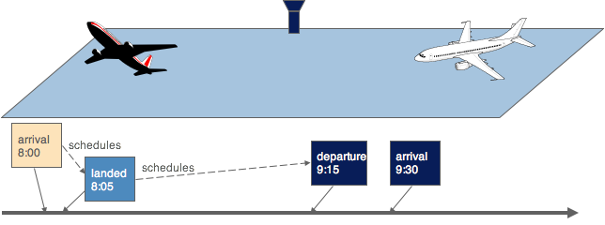
DES example: air traffic
each plane is independently represented
as a component, so is the runway
Event scheduling from one component to another progresses and
coordinates virtual time across components
Example from slides by Prof Carothers, RPI

Slide 92
Implementing DES
ROSS lets users define LP (logical processes) on which events can be scheduled with time stamps
Each LP can have a local state that is accessible and modified only when events are executed on it

Slide 93
ROSS LP
tw_lptype model_lps[] = {
{
(init_f) model_init,
(event_f) model_event,
(revent_f) model_event_reverse,
(final_f) model_final,
(map_f) model_map,
sizeof(state)
},
};

Slide 94
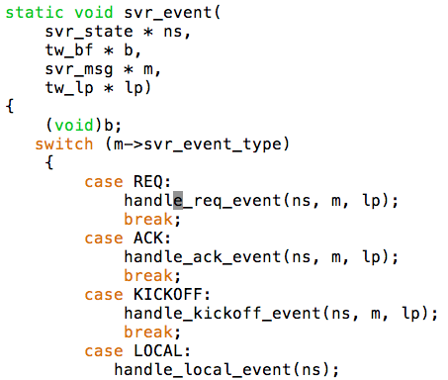
Example of an event function
Typical events act based on “type” and “content” of the message

Slide 95
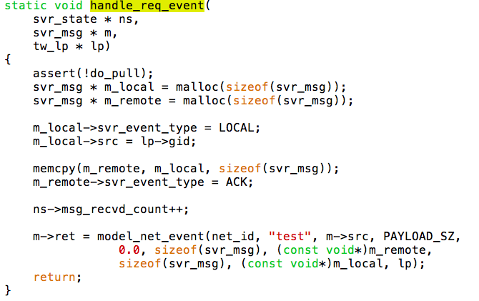

Slide 96
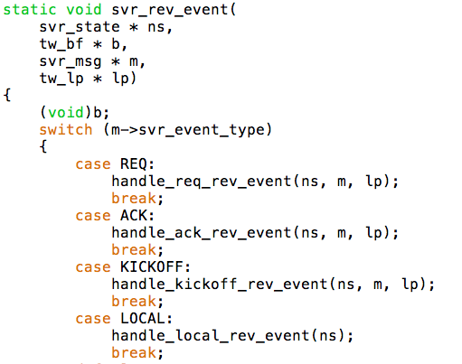
ROSS’s law of optimistic execution: for every forward action, you must tell ROSS how to go backwards

Slide 97
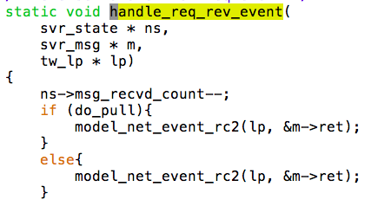

Slide 98

Application simulation IN CODES
packet send
ack/token send
packet send
ack/token send
message send
NIC
— messages to be transmitted
— packetization status of messages being transmitted
— data on buffers connecting to router
— NIC delay
— bandwidth to routers
Routers
— routing tables
— data on buffers connecting to other routers and NIC
— congestion control scheme
— pending packets in each buffer
— link bandwidth
— router delays
PE 0 (mpi rank or end points)
— computation tasks, communication logs, or algorithmic state
— expected messages
— pending messages
— progress overheads
packet arrive
ack/token arrive
message arrive
packet arrive
ack/token send
task complete

Slide 99
Available models, features, and adding a new network models
Available: simple-net model, torus, dragonfly-(custom), fat-tree, slim fly, express-mesh/hyperX
Typical model consist of NIC (terminals) and switches/routers
NICs
Common code available for within-node, message ordering, etc
Plugin code for individual network
Switch/routers
Entirely within a network model
But, a significant fraction of node is similar for NIC plugin and switch!

Slide 100
NIC Common
Types of queues:
fifo
round-robin
priority
Other params
intra_bandwidth (10)
node_copy_queues (4)

Slide 101
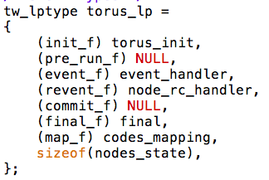
NIC Network Specific
struct model_net_method torus_method =
{
.mn_configure = torus_configure,
.mn_register = NULL,
.model_net_method_packet_event = torus_packet_event,
.model_net_method_packet_event_rc = torus_packet_event_rc,
.model_net_method_recv_msg_event = NULL,
.model_net_method_recv_msg_event_rc = NULL,
.mn_get_lp_type = torus_get_lp_type,
.mn_get_msg_sz = torus_get_msg_sz,
.mn_report_stats = torus_report_stats,
.mn_collective_call = NULL,
.mn_collective_call_rc = NULL,
.mn_sample_fn = NULL,
.mn_sample_rc_fn = NULL,
.mn_sample_init_fn = NULL,
.mn_sample_fini_fn = NULL
};

Slide 102
NIC Network Specific

Slide 103
CONTRIBUTING:
Fork off on the github repository
Add new features
Submit a pull request!
Thank-you

Slide 104
ADDITIONAL MATERIAL

Slide 105
Codes installation

Slide 106
installation & setup 1/2
ROSS INSTALLATION
Download ROSS repo: git clone https://github.com/ROSS-org/ROSS
Configure by making a build directory: cd build
ARCH=x86_64 CC=mpicc CXX=mpicxx cmake
-DCMAKE_INSTALL_PREFIX=../install ../
make –j 3 && make install
CODES INSTALLATION
Download CODES repo: git clone https://github.com/codes-org/codes
./prepare.sh
Configure in build directory: cd build
../configure --prefix=/path/to/install CC=mpicc CXX=mpicxx PKG_CONFIG_PATH=/path/to/ross/install/lib/pkgconfig
Do both make && make tests

Slide 107
Installation & setup 2/2
DUMPI INSTALLATION
git clone https://github.com/sstsimulator/sst-dumpi
CFLAGS="-DMPICH_SUPPRESS_PROTOTYPES=1 -DHAVE_PRAGMA_HP_SEC_DEF=1"
./bootstrap.sh
./configure --enable-libundumpi CC=mpicc --prefix=$INSTALL_PATH
Use –with-dumpi=/path/to/dumpi/install option to enable DUMPI with CODES
OTF2 and BigSim based Tracing
ScoreP/OTF2: http://www.vi-hps.org/projects/score-p/
Charm++/BigSim:http://charm.cs.illinois.edu/manuals/html/bigsim/manual.html
TraceR: https://github.com/LLNL/tracer/
For installation details and documentation see:
https://xgitlab.cels.anl.gov/codes/codes/wikis/home
https://xgitlab.cels.anl.gov/codes/codes/wikis/installation

Slide 108
MORE ON TraceR

Slide 109
TraceR – a layer for configurable replay of application traces
Capture application behavior by tracing runs on existing systems
Reproducing the execution: applications’ behavior,
job placement and mapping, job scheduling, MPI/Charm++, etc.
Simulation of traffic flow on NICs and networks

Slide 110
DOCUMENTATION
Distributed with TraceR source code
README.md – getting started
README.OTF - OTF2 installation and usage
docs/UserWriteUp.txt – detailed workflow and usage
utils/README – job placement and task mapping

Slide 111
Installing TraceR (1/4)
Hosted on github: https://github.com/LLNL/tracer/
git clone and follow README.md
Download and install ROSS
Last verified commit provided
Download and install CODES
Last verified commit provided

Slide 112
Installing TraceR (2/4)
Choose a trace format: BigSim or OTF2
For BigSim, download Charm++
git clone http://charm.cs.uiuc.edu/gerrit/charm
Assuming MPI is available, install two flavors of Charm++
For compiling codes for trace generation ./build bgampi mpi-linux-x86_64 bigemulator –O2
For compiling TraceR ./build charm++ mpi-linux-x86_64 bigemulator --with-production

Slide 113
Installing TraceR (3/4)
For OTF2, download ScoreP
http://www.vi-hps.org/projects/score-p/
Inside ScoreP source directory
CC=mpicc CFLAGS="-O2" CXX=mpicxx CXXFLAGS="-O2" FC=mpif90 F77=mpif77 ./configure --without-gui --prefix=<SCOREP_INSTALL>
make && make install
Make sure ScoreP installation’s bin directory is in PATH

Slide 114
Installing TraceR (4/4)
In tracer/Makefile.common
Set ROSS to ROSS’s installation directory
Set CODES to CODES’s installation directory
If using BigSim,
Set CHARMPATH
SELECT_TRACE = -DTRACER_BIGSIM_TRACES=1
If using OTF2,
Make sure ScoreP installation’s bin directory is in PATH
SELECT_TRACE = -DTRACER_OTF_TRACES=1
make: generates traceR executable

Slide 115
More on Generating OTF2 traces
ScoreP macros can be used to mark special regions
SCOREP_USER_REGION_BY_NAME_BEGIN( regionname, SCOREP_USER_REGION_TYPE_COMMON)
SCOREP_USER_REGION_BY_NAME_END(regionname)
Printing simulation time at locations of interest:
Region name with prefix TRACER_WallTime_<any_name> prints current time during simulation with tag <any_name>.

Slide 116
More on Generating OTF2 traces
Simulation time looping:
Region name TRACER_Loop can be used to mark beginning and ending of a code loop (currently once)
In future, region names will be used for
Targeted kernel time modifications
Targeted message size modifications

Slide 117
Code example for tracing with OTF2
while(iterations < MAX_ITER) {
if(myRank == 0)
SCOREP_USER_REGION_BY_NAME_BEGIN ("TRACER_WallTime_InLoop", SCOREP_USER_REGION_TYPE_COMMON);
//kernel and other code
}
SCOREP_USER_REGION_BY_NAME_END ("TRACER_Loop");
MPI_Barrier(MPI_COMM_WORLD);
endTime = MPI_Wtime();
if(!myRank)
SCOREP_USER_REGION_BY_NAME_END ("TRACER_WallTime_Total");
SCOREP_RECORDING_OFF();
int main(int argc, char **argv) {
MPI_Init(&argc, &argv);
SCOREP_RECORDING_OFF();
//initializaton code
MPI_Barrier(MPI_COMM_WORLD);
SCOREP_RECORDING_ON();
SCOREP_USER_REGION_BY_NAME_BEGIN ("TRACER_Loop", SCOREP_USER_REGION_TYPE_COMMON);
if(!myRank)
SCOREP_USER_REGION_BY_NAME_BEGIN ("TRACER_WallTime_Total", SCOREP_USER_REGION_TYPE_COMMON);
startTime = MPI_Wtime();

Slide 118
Running TraceR
A typical run command: mpirun -np 8 ./traceR --sync=3 --nkp=16 --extramem=100000 --max-opt-lookahead=1000000 --timer-frequency=1000 –lp-io-dir=stats-dir -- torus.conf tracer_config
In green, ROSS options
--nkp : how many KPs to create per PE = total LPs/<-np>
--extramem : how many ROSS messages to allocate = 100K should work for most cases
--max-opt-lookahead : optimistic leash = 1 millisecond is a good number

Slide 119
Running TraceR
A typical run command: mpirun -np 8 ./traceR --sync=3 --nkp=16 --extramem=100000 --max-opt-lookahead=1000000 --timer-frequency=1000 –lp-io-dir=stats-dir -- torus.conf tracer_config
TraceR-CODES options
--timer-frequency : how frequently to print progress of task completion; optional, default = 5000
--lp-io-dir : where to write output stats; optional; code fails if the directory exists to avoid over-writing
torus.conf : network config file
tracer_config : TraceR config file

Slide 120
TraceR parameter in network file
server in MODELNET_GRP
Number of processes associated with a switch
Assigned in a round-robin manner to nodes
soft_delay in PARAMS
Approximate overhead of making an MPI/runtime call
In nanoseconds
rdma_delay in PARAMS
Overhead of using RDMA call in rzv protocol, in nanoseconds
eager_limit in PARAMS
Switch over point between eager and rzv protocols, in bytes
copy_per_byte in PARAMS
Copy cost for a byte, in nanoseconds per byte

Slide 121
TraceR config file (1/2)
Format:
<global map file> or NA
#jobs
<path to job traces> <task mapping file or NA> <#ranks> <loop iterations>
Example:
global_map.bin
2
traces-64/traces.otf2 job0 64 1
traces-32/traces.otf2 job1 32 1

Slide 122
TraceR config file (2/2)
At the end of file,
E <job id> scale_all <scale factor>
Inverse scales computation time by the given factor
E.g. : E 0 scale_all 40
S <job id> <msg size> <replace by>
Change the size of message
Under review, to be merged

Slide 123
Sample output
PE0 - LP_GID:0 : START SIMULATION, TASKS COUNT: 245611, FIRST TASK: 0, RUN TIME TILL NOW=70.000000 s, CURRENT SIM TIME 1.005877
[ 0 0 : time at task 0/245611 0.000000 ]
[ 0 0 : Begin TRACER_WallTime_MainLoop 0.000001 ]
[ 0 0 : time at task 100/245611 0.000663 ]
[ 0 0 : Begin TRACER_WallTime_NextTrajec 0.001175 ]
[ 0 0 : time at task 200/245611 0.003104 ]
….
….
[ 0 0 : time at task 245600/245611 1.485123 ]
[ 0 0 : End TRACER_WallTime_NextTrajec 1.485264 ]
[ 0 0 : End TRACER_WallTime_MainLoop 1.485265 ]

Slide 124
Case studies with codes-tracer

Slide 125
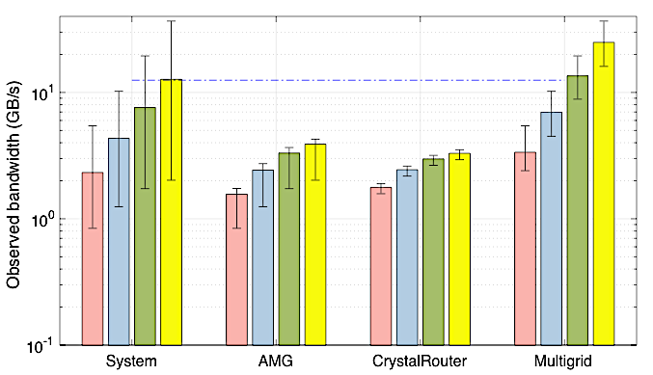
Evaluating Methods for Effective Fat-tree Utilization
Quantify the effectiveness of multiple network rails in increasing network performance
Evaluate job placement methodologies and routing choices to maximize the throughput of a multi-rail fat-tree network
Investigate network performance gains offered by multiple rails in response to increased compute performance of high-density compute nodes
Improve routing, injection and job allocation design choices of multi-rail fat-tree networks to maximize individual application and system wide performance
Fat-tree strong scaling rail performance
Multi-application workload
Linear system improvement
Related papers
Jain et al. Predicting the Performance Impact of Different Fat-Tree Configurations (To appear in Supercomputing 2017)
Wolfe et al. Preliminary Performance Analysis of Multi-Rail Fat-tree Networks (CCGRID 2017)
Notes:
Simulation Configuration:
3,564 node fat-tree using 36-port switches
All configurations use EDR 12.5Gb/s speeds
13,824 ranks AMG
1,000 ranks CR
10,648 ranks MG
Comments on Results:
Some applications such as Multigrid with bursty periods of large data transfers can benefit from the additional bandwidth and diversity of additional rails
Other applications like AMG and Crystal Router that have synchronized communication patterns of small data transfers do not observe performance improvements

Slide 126
Visualizing HPC Interconnect Performance
Comparing job placement schemes using the CODES simulation framework of the high-radix dragonfly network running the Algebraic Multigrid Solver (AMG), AMR BoxLib and MiniFE applications. The visualizations show the aggregated network view of all the routers and network links.
K. Li, M. Mubarak, R. Ross et al. “Visual Analytics Techniques for Exploring the Design-space of large-scale high-radix networks”, to appear in IEEE Cluster 2017

Slide 127
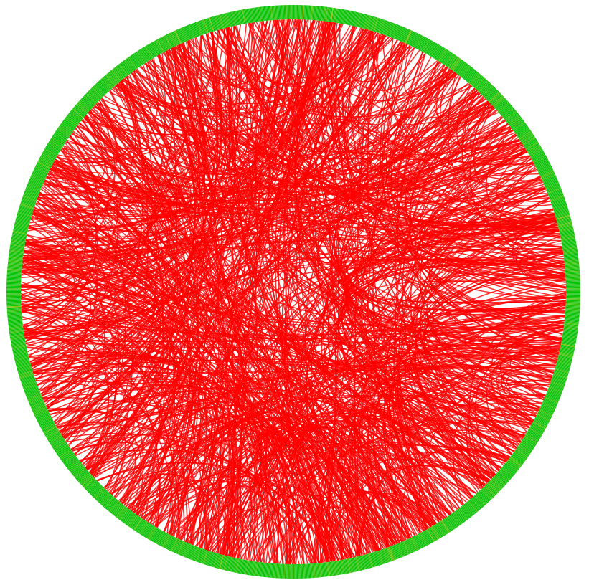

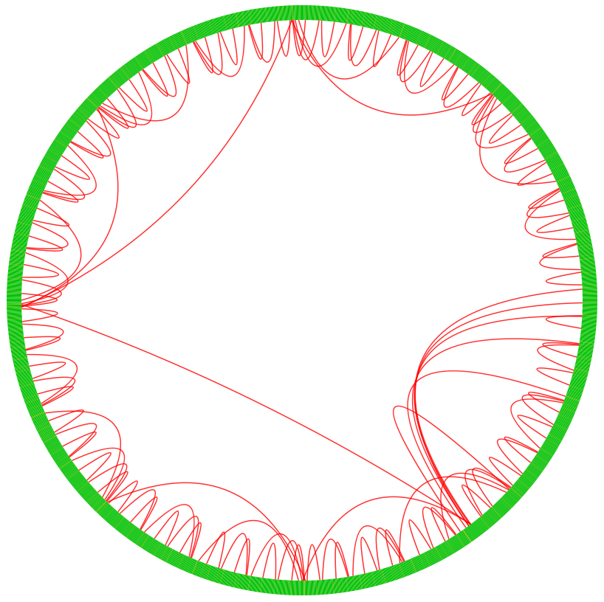
Accelerating Collective Communication on Dragonfly Networks
Need to design new scalable collective algorithms for high-radix interconnects
Investigate the parameter space of these algorithms, and the effects of cross-application communication interference
Designed/evaluated several collective algorithms for Dragonfly networks
(a) Tree (Non topology aware) (b) Local Links First (topology-aware) (c) Global Links First
M. Dorier et al. “Evaluation of Topology-Aware Broadcast Algorithms for Dragonfly Networks ”, IEEE Cluster 2016

Slide 128
Using model-net api

Slide 129
configuration
Model-net– An abstraction layer on top of network models – topology details are specified through the config files
A valid network configuration file – examples can be found in the repo
Network model must be registered – model_net_register
CODES mapping must be setup – codes_mapping_setup
Use model-net function calls – model_net_event(network id, source, destination, message size,…)
Example of using model-net – tests/model-net-test.c

